Slide 1

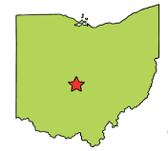
COC ASSP
May 2026

Slide 2
Upcoming Events
18th Annual Golf Outing!
  Thursday, June 11, 2026
  Glenross Golf Club
  8:30am shotgun start, 7:30am signup
  TODAY IS THE LAST DAY TO SIGN UP TO PLAY OR SPONSOR!
  Please get with Samantha after the meeting to iron out any outstanding details, if you haven’t already.
  2026-2027 Chapter Meetings will start in August/September 2026; keep an eye out for emails and invites!
  Enjoy the summer!
https://centralohio.assp.org/event/

Slide 3
Elections!
TODAY – we will be voting for the following positions:
  President (1 person running)
  VP (1 person running)
  Secretary (1 person running)
  Treasurer (1 person running)
All IN-PERSON attendees will receive a paper ballot.
Please mark your choice for each of the positions listed.
After you are finished, please fold you ballot in half and bring it to the front of the room.
We will count ballots before we move on to the presentation.

Slide 4
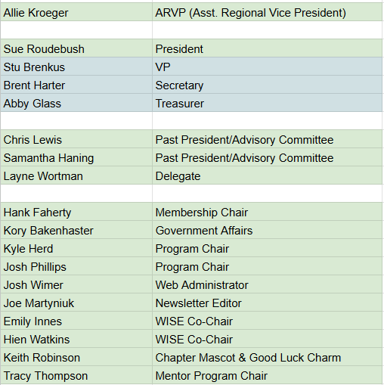
2026-2027 Volunteer Leaders
Beginning July 1, 2026, these are your new Volunteer Leaders!

Slide 5
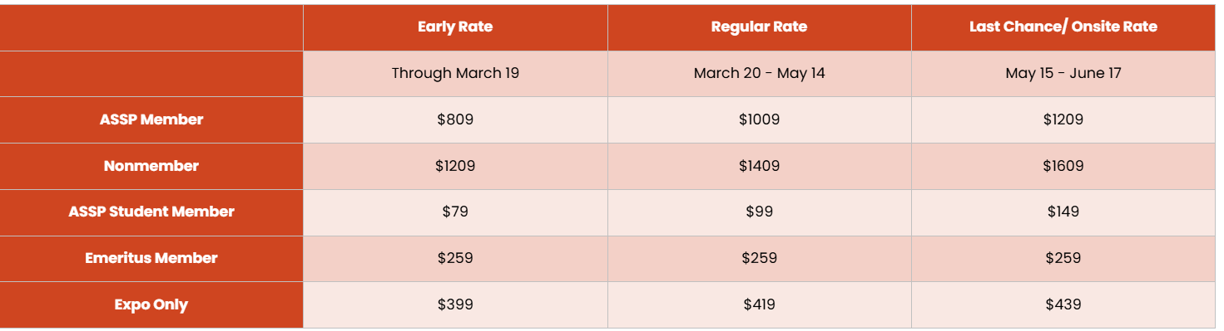
ASSP Safety Conference 2026
Be thinking about Safety 2026!
Registration is now open!
WHEN:
June 12-14, 2026: Pre-Conference Courses
June 15-17, 2026: Conference & Expo
WHERE:Anaheim, CA @ Anaheim Convention Center
Link: ASSP Safety 2026 | Annual Safety Conference + Expo

Slide 6
2025-2026 Highlights

Slide 7
Meeting Numbers
The Central OH Chapter hosted a total of 13 Meetings in 2025-2026
  3 tours (Shelly Quarry, Fire Academy, AEP Transmission Training Site)
  10 meetings (one each month)
    9 of 10 were hybrid, 1 in-person only
  2 socials (Holiday Social and BWC Social)
  Offered CEUs at 4 meetings
  Around 23 people in attendance per meeting (in-person & virtually combined)
HOT TOPICS
  PFAS/Dark Waters with Rob Bilott of Taft
  Influencing without Authority with Abby Glass of Vertiv
  Federal OHSA Updates with Conor Meeks with Taft
  AI Panel Discussion
  Digital Twin with Chet Brandon of Hexion

Slide 8

ASSP Training Opportunities

