Slide 1

Safety in Sight: Mapping EHS Data for Smarter Decisions
Samantha Haning, B.S., M.S.
Global EHS Systems Manager for Vertiv
March 20, 2026
Notes:
Introduce yourself, the topic, and set the tone for why visual communication matters in EHS.

Slide 2




Fun Stuff/Hobbies:
Bachelor of Science in Engineering Technology & Management 2017 from Ohio University
Master of Science in Industrial Systems Engineering (Emphasis in OSH) 2019 from Ohio University
Motorsports Enthusiast – trucks, tractors, NASCAR – you name it, we enjoy it
ASSP Member since 2019 (have held office of Sec., VP, President)
Six Sigma Yellow & Green Belt
CPR Instructor
OSHA 10 & 30 in both Construction and General Industry
Smartsheet Certified
Fun Facts:
I’m allergic to peanuts, but no other nut!
I was a DJ for a well-known radio station while I was in high school and college. Sometimes people still call me by my DJ name, if they knew me then. My DJ name was KC Storm.
Career:
Safety Intern at Bellisio Foods (food industry) for 1.5 years (don’t ask me about pizza rolls!). Worked with USDA & FDA during this time.
Safety Engineer at Stanley Electric U.S. (auto industry) for 2 years. If you’ve ever seen a Honda, chances are this location made the lights!
Global EHS Systems Manager at Vertiv since October 2025, EHS Engineer prior to that (just over 4 years). Own and manage multiple software platforms, along with supporting both Services and MFG EHS functions globally. Jack of all trades – master of none!
Why Safety?
I come from a family of blue-collar workers (farmers, miners, mechanics) and originally was going into Manufacturing Engineering. I had an opportunity to learn about OSH and took the leap! I challenge my workforce to try “my way” instead of forcing Safety. Safety is PERSONAL. 3 questions I’ve asked every employee I’ve had the honor of training:
  Who is the most important people in your life?
  What are your favorite hobbies or past times?
  Why should you be safe?
Notes:
Briefly share your background and connect your experiences to the importance of good data design.

Slide 4
Agenda
Why EHS Data Matters
Turning Observations Into Actions
When Data Gets Lost in Translation
From Data to Insight
Communicating Effectively
Building Your Visualization Toolkit

Slide 5
Why EHS Data Matters
What Role EHS Plays in a Company/Business Objective
Role of data in Identifying Risks and Ensuring Compliance
Driving Continuous Improvement through Data
Protects the business by managing risks, ensuring regulatory compliance, and preventing costly incidents or legal issues
Drives performance through safer, more efficient operations, improved employee well-being, and reduced downtime
Supports strategic goals, like sustainability, ESG alignment, and brand reputation, contributing to long-term financial success
Identifies risks proactively by analyzing trends in incidents, near misses, and safety observations to uncover patterns and predict potential hazards.
Ensures regulatory compliance through tracking of permits, inspections, corrective actions, and maintaining audit-ready documentation.
Supports informed decision-making by highlighting risk severity and compliance gaps, helping prioritize safety and operational improvements.
Monitor and analyze trends in incidents, audits, and observations to identify recurring issues and areas for improvement.
Track corrective and preventive actions (CAPAs) to ensure issues are resolved effectively and lessons are applied across operations.
Use performance metrics and dashboards to set goals, measure progress, and engage teams in ongoing safety and sustainability efforts.
EHS data empowers organizations to proactively manage risks, ensure compliance, and drive continuous improvement by turning safety insights into strategic actions.
Notes:
Explain why EHS data matters and how it supports business performance and compliance.

Slide 6
Turning Observations into Actions
Types of EHS Data
Supports Risk Identification & Regulatory Compliance
Enables Performance Tracking & Strategic Decision-Making
Incident Data – Records of workplace injuries, near misses, and safety observations.
Compliance Data – Information on regulatory requirements, audits, and inspections.
Environmental Metrics – Data on emissions, waste management, and resource usage.
Hazard Recognition – Helps identify potential safety and environmental risks through trend analysis and incident reporting.
Regulatory Tracking – Ensures adherence to local, state, and federal requirements by monitoring compliance data.
Preventative Action Planning – Provides insights for implementing controls and corrective measures to reduce future risks.
Trend Analysis – Monitors key safety and environmental metrics over time to identify improvement areas.
Benchmarking – Compares performance against industry standards or internal goals to measure progress.
Data-Driven Planning – Supports informed decisions for resource allocation, risk mitigation, and long-term sustainability strategies.
EHS data is essential for identifying risks, ensuring compliance, tracking performance, and guiding strategic decisions that drive safety and sustainability.
Notes:
Discuss how observations turn into actions and why accurate data capture is essential.

Slide 7
Turning Observations into Actions
Incident & Near Miss Reporting
Behavior Based Safety Programs
Enables Performance Tracking & Strategic Decision-Making
Captures Critical Events – Documents workplace incidents and near misses to identify hazards and prevent recurrence.
Supports Root Cause Analysis – Provides detailed information for investigating underlying causes and improving safety processes.
Drives Continuous Improvement – Enables trend tracking and proactive measures to reduce future risks and enhance safety culture.
Observation Tracking – Collects data on safe and at-risk behaviors to identify trends and reinforce positive actions.
Employee Engagement Metrics – Measures participation in safety observations and feedback to strengthen safety culture.
Actionable Insights – Analyzes behavior data to develop targeted interventions and training for risk reduction.
Monitors Key Metrics – Tracks safety, health, and environmental performance indicators to measure progress and identify gaps.
Supports Predictive Analysis – Uses historical data to forecast trends and anticipate potential risks or compliance issues.
Informs Strategic Planning – Provides actionable insights for setting goals, allocating resources, and driving continuous improvement.
EHS data empowers organizations to capture incidents, monitor behaviors, and track performance, enabling informed decisions that enhance safety culture and drive continuous improvement.
Notes:
Expand on incident vs behavior data and how both feed proactive risk reduction.

Slide 8
The Problem with Raw Data
Too Much Noise, Not Enough Clarity
Missing Context & Baselines
Inconsistent or Poor-Quality Data
Large, unfiltered datasets make it hard to see what matters – key risks get buried under excessive tables, fields, and inconsistent inputs.
Numbers alone don’t tell the story. Without rates, comparisons, or historical trends, it’s impossible to judge whether performance is improving or declining.
Different terminology, manual entry errors, duplicates, and incomplete records all reduce data reliability and distort trendlines.
Data Scattered Across Multiple Systems
Hard to Spot Trends or Priorities
Slow and Difficult for Teams to Interpret
Incidents in one tool, audits in another, training somewhere else – fragmented systems prevent a unified view of risk.
Raw tables hide patterns, severity, and emerging issues. Nothing highlights what needs attention now versus what can wait.
Frontline employees and leaders disengage when data is confusing or time-consuming to understand, limiting action and buy-in.
Notes:
Raw data is hard to read and digest, visualization creates something easy to understand

Slide 9
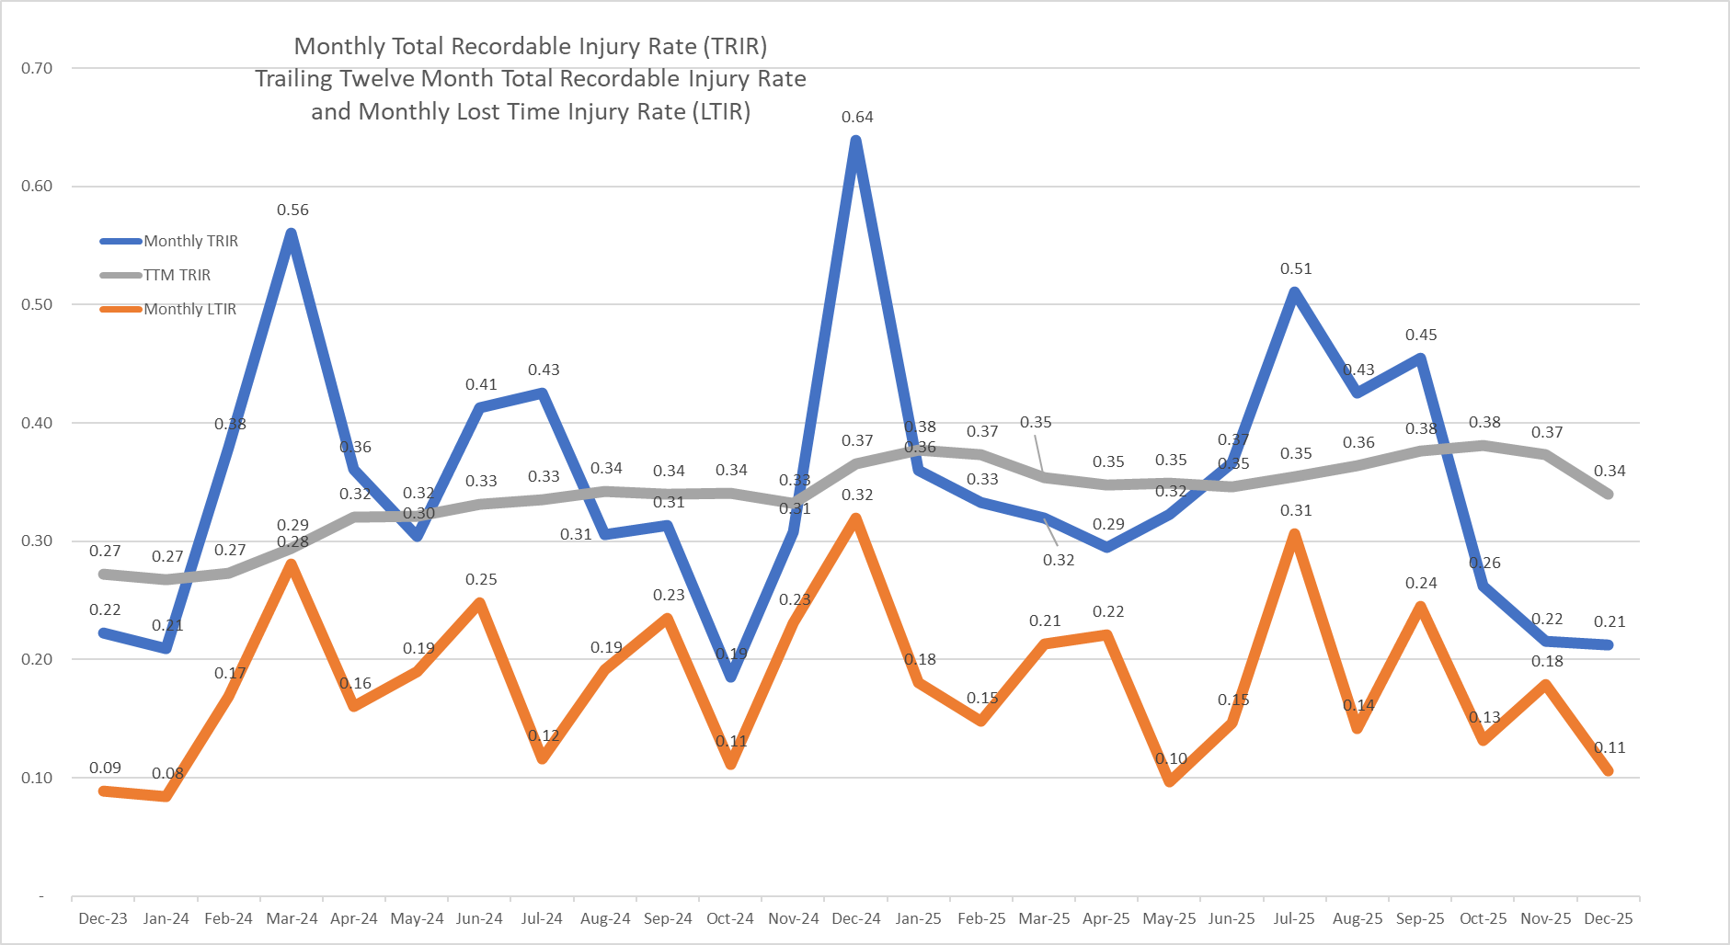
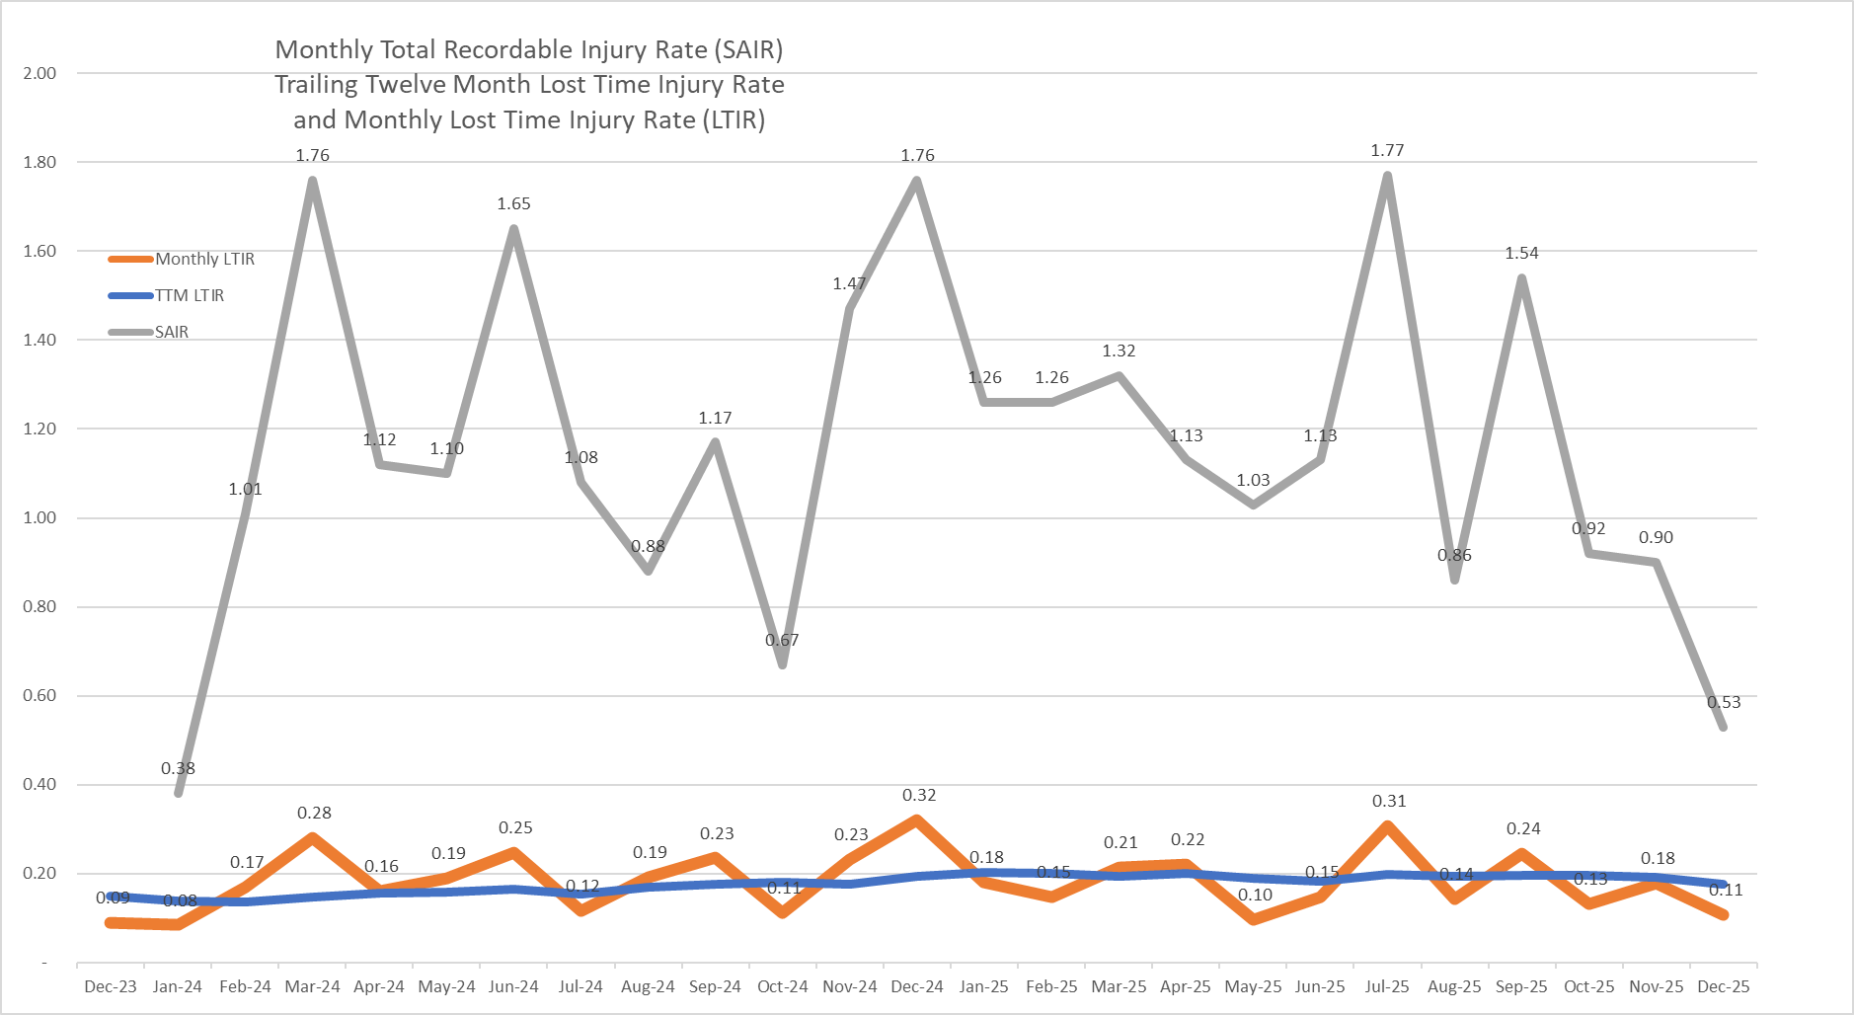
The Problem with Raw Data
Notes:
Raw data is hard to read and digest, visualization creates something easy to understand

Slide 10
SAIR (Severity Adjusted Injury Rate)
New Safety Metric

Slide 11
When Data Gets Lost in Translation
Common Communication Issues
Consequences
    Data overload - too many charts or tables overwhelm the audience
    Lack of context - numbers shown without baselines or definitions
    Inconsistent terminology across teams
    Poor visual design that hides key insights
    Unclear ownership - no clarity on who should act
    Lagging or outdated data delays decision‑making
    Critical risks are missed
    Leadership disengages
    Workers lose trust in the data
    Prevention opportunities are lost
Clear, contextual communication determines whether data leads to action.
Notes:
Despite having valuable data, many organizations struggle to communicate it effectively. This slide highlights common pitfalls that hinder understanding.

Slide 12
From Data to Insight
Simplifies
Complex
Data
Reveals
Patterns &
Trends
Engages
Stakeholders
Drives Faster
Decision
Making

Slide 13
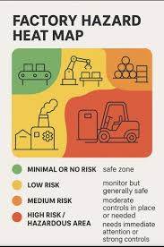
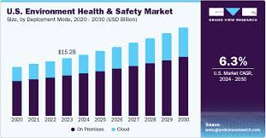
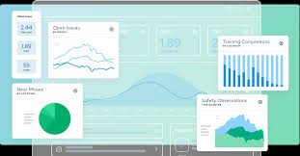
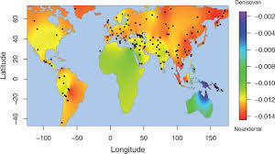
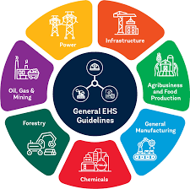
Visualization Tools for EHS Success
Charts
Heatmaps
Dashboards
Infographics
Geographic Maps
Ideal for trend analysis, comparisons, and KPI monitoring
Highlight hotspots across locations, processes, or risk areas
Combine multiple data sources for real-time insight and leadership visibility
Simplify complex concepts for quick understanding and engagement
Reveal regional performance patterns and emerging risk trends
Choose visuals intentionally — each tool tells a different story.
Notes:
Here are some effective visualization techniques. Each method serves a different purpose, from tracking trends to highlighting risk areas.

Slide 14
Communicating Effectively
Know Your
Audience!
Use Clean,
Consistent
Formats
Highlight
Key Metrics
Include
Context

Slide 15
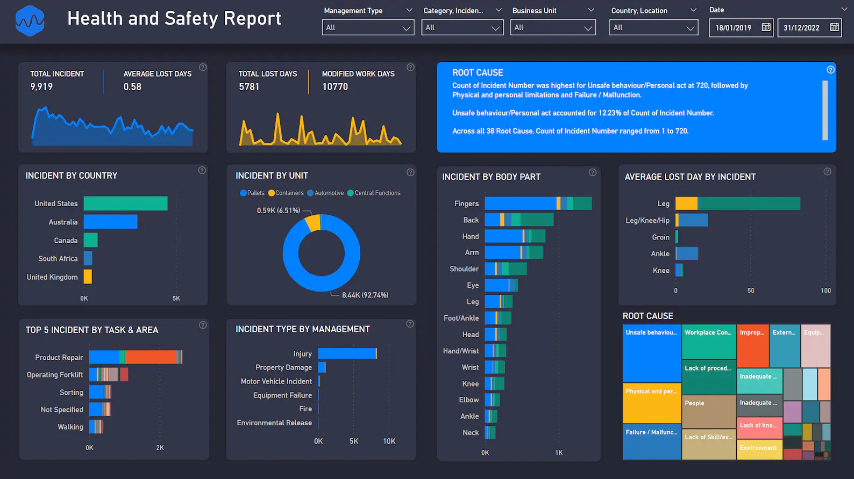

Slide 16
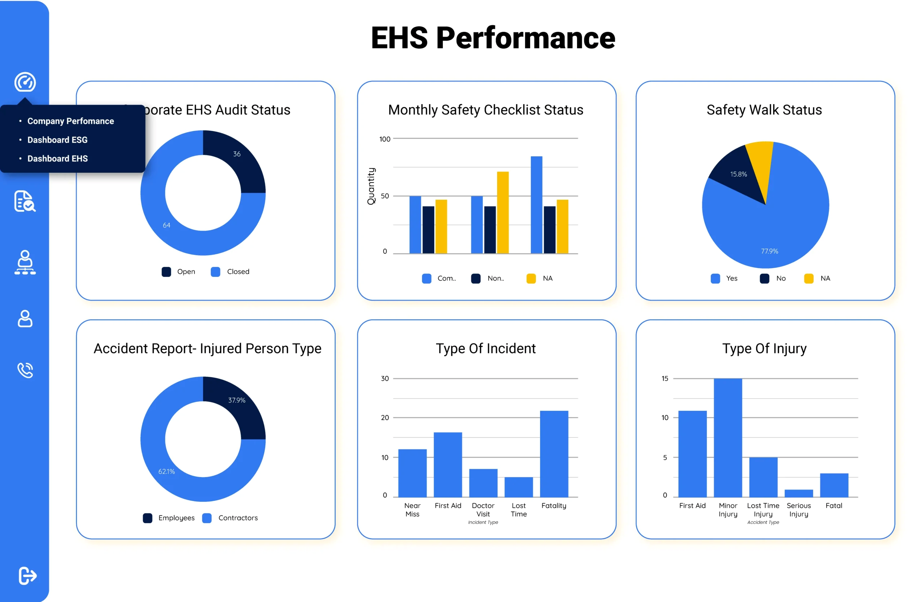

Slide 17
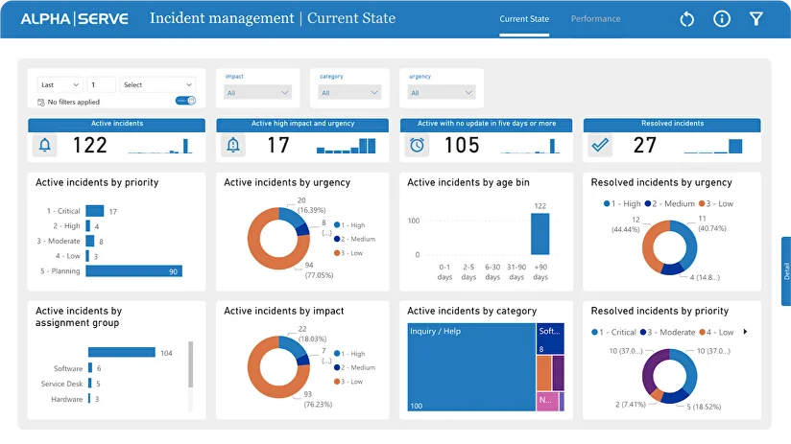

Slide 18
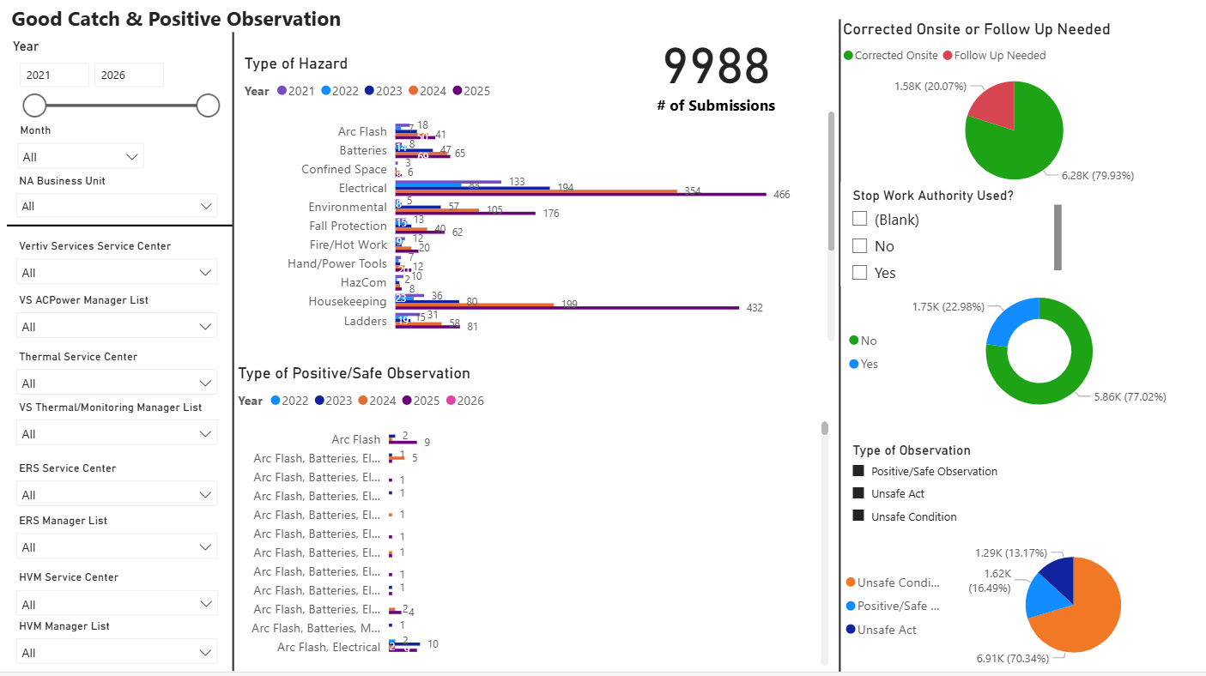

Slide 19
Building Your Visualization Toolkit
Software Options
Integration with EHS Management Systems
Automation and Real-Time Data Feeds
There are many options when it comes to software!
Power BI
Tableau
Excel
Smartsheet
EHS Platforms
Creates a single source of truth
Reduces manual effort and errors
Improves visibility and transparency
Scheduled refreshes
Automated alerts and workflows
Proactive notification of key changes
Integrate your tools, automate wherever possible, and use dashboards to keep teams aligned and communication clear.
Notes:
There are many tools available for creating EHS visuals. Choose one that integrates well with your data sources and supports real-time updates.
Do this as a voiceover when displaying the demo.

Slide 20
Empowering Safety Through Data
Recap
  We walked through how we can take all the EHS data we collect and turn it into something people actually understand and use.
  We looked at the common ways our messages get lost and how better visuals—charts, dashboards, maps—can make insights pop.
  In the end, it’s all about helping teams make safer, smarter decisions with clearer information.
Invest in data literacy among your EHS teams.
Invest in software and other visualization tools!
Deliver the best decisions based on the data.
Notes:
To conclude, EHS data is powerful when communicated effectively. Invest in the right tools and practices to make your data work for you.

