Slide 1
Fall Protection
ANSI Z359.14-2021
Presented by Matt Hohman

Slide 2
Introduction
Matt Hohman
  Regional Sales Manager at FallTech
  Territory of Ohio and Michigan
  Located in Northeast Ohio
FallTech
  Manufacturer of Fall Protection Equipment
  Designed, and Tested in the US
  ISO 17025 Lab
  Located in Compton, California

Slide 3
Agenda
ANSI Z359.14-2021 Overview
Why a New Standard
Compliance to Z359.14 2021
Complications with Z359.14-2021
Leading Edge

Slide 4
ANSI Z359.14-2021 Basics
  What is ANSI Z359.14-2021
  Effective Date: August 1, 2023
  Elimination of Class A & B
  Standardized labeling
  More stringent testing

Slide 5
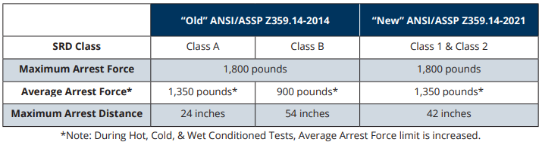
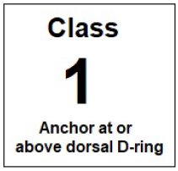
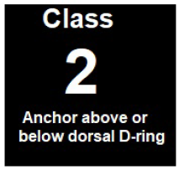
Why a New Standard
Class 1 devices
    Above or at D-ring anchorage
Class 2 devices
    Above, at, or up to 5’ below back D-ring anchorage
    Must be Leading Edge rated

Slide 7
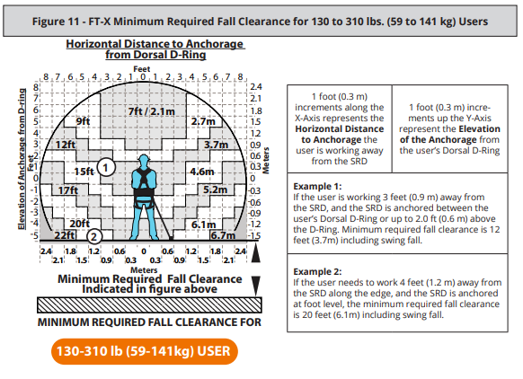
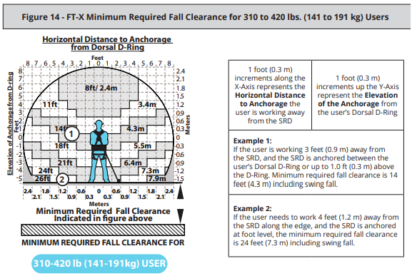
FT-X Labeling

Slide 8
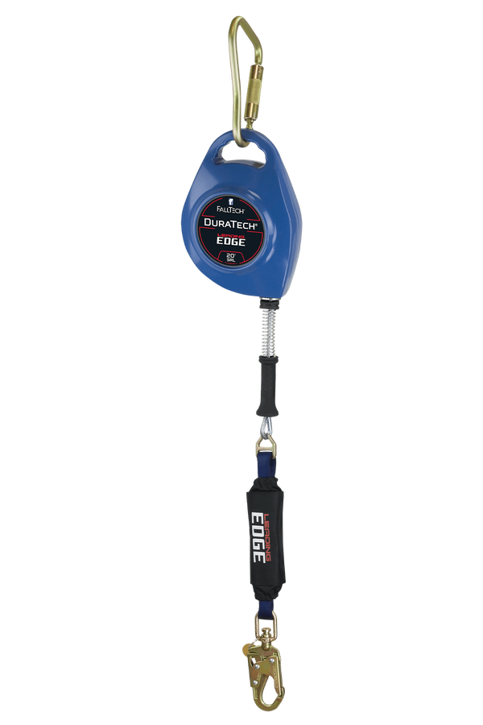
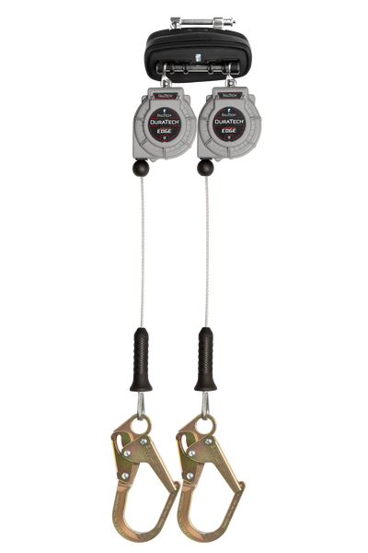
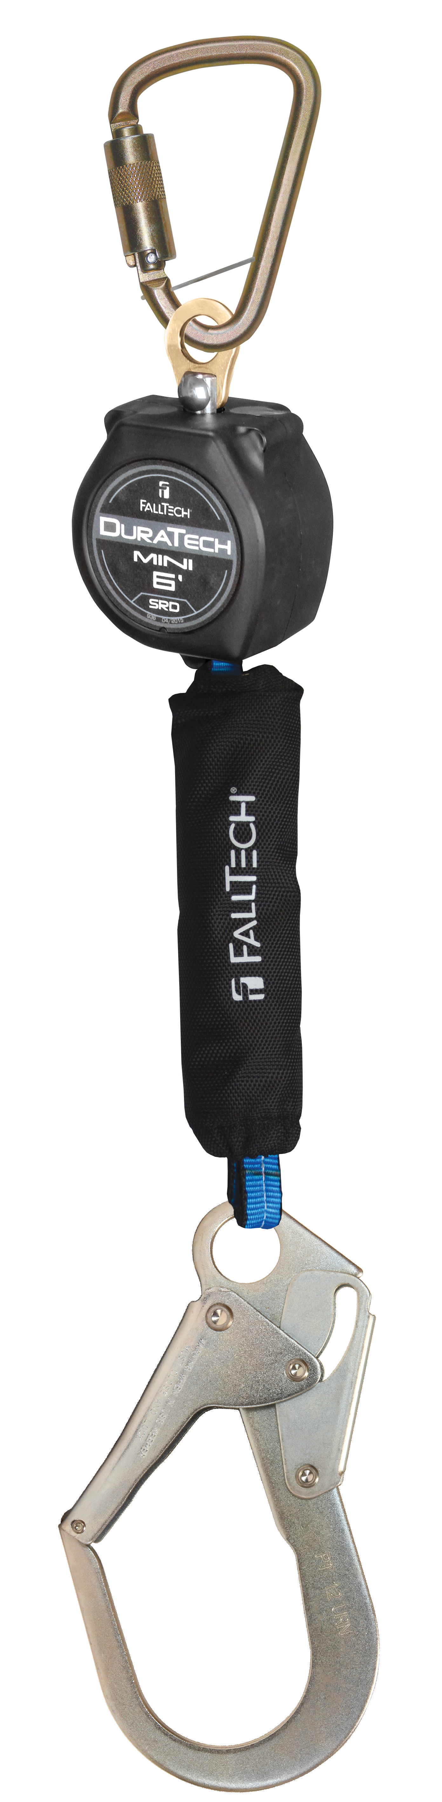
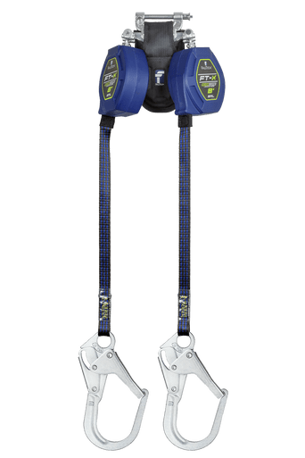
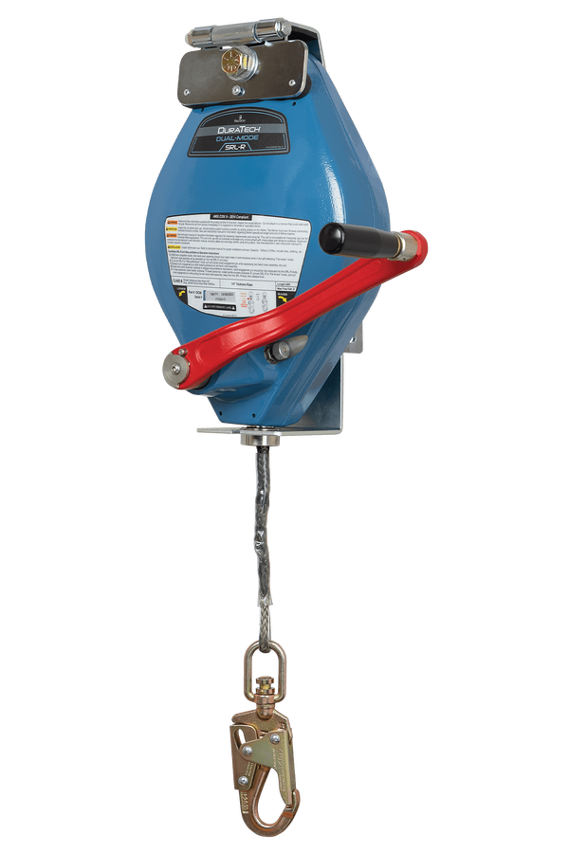
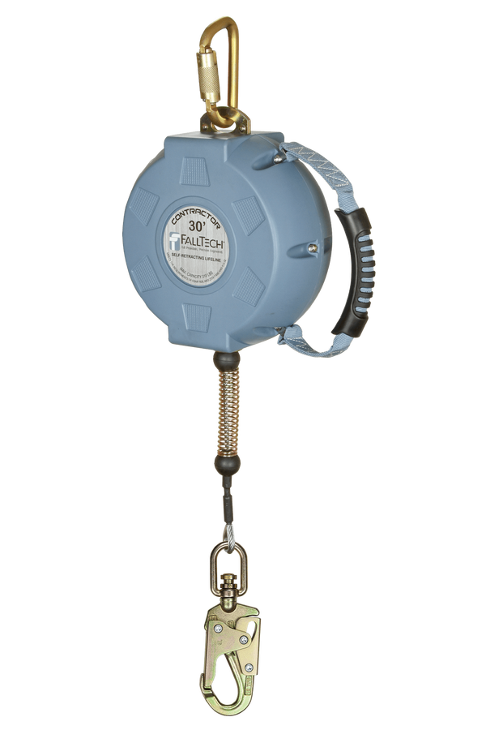
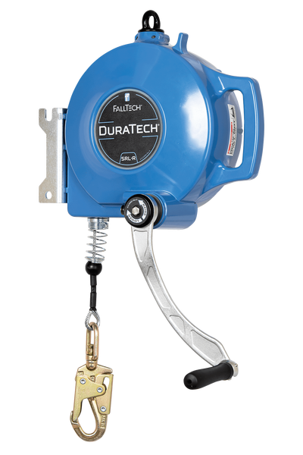
Why a New Standard
SRL
SRL-P
SRL-R

Slide 9
Why a New Standard
More Stringent Testing
  Testing mass now 310lbs previously 282lbs
  Static pull test now 3600lbs previously 3000lbs
    Stainless and 3/16 Cable Challenges
  Twin SRL testing (in response to the 3M Nano-Lok Edge Recall)
  Twin SRL connectors (5073J)
  Tie-back SRL wraparound beam testing
  Tie-back SRL webbing abrasion testing
  Locked Pawl Testing
  SRL-P Misuse Testing

Slide 10
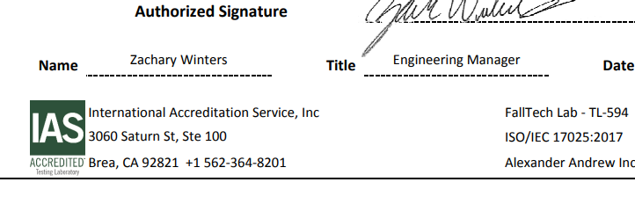
Compliance to Z359.14 2021
Manufacturer DOC’s
  Accreditation Lab Identification
“Grandfathering”
ANSI Z359.14-2014 Products
  August 1st, 2021
OSHA Compliance or “Outside the Scope of ANSI”

Slide 11
Complications with ANSI Z359.14-2021
MEWP, Manlift, Elevated work platform
  Restraint
  ANSI Compliance
  “Outside the Scope of ANSI”
Labeling and Interpretation of Class 1 devices
LOI or White Papers

Slide 12
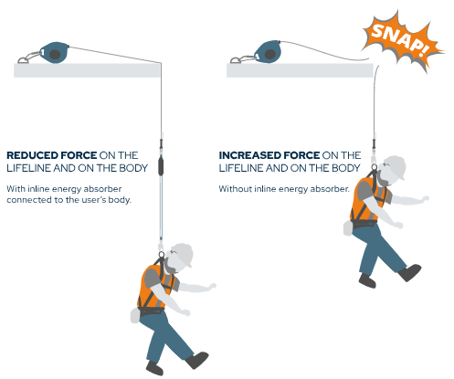
Leading Edge
Consider “Edge Hazard” or “Class 2”
Placement of Energy Absorber
Testing requirements
  .005 sharp steel
  No other substrate is required

Slide 13
Disclosure
It is critical that you consult your designated supervisor or safety professional if you notice a potential hazard within your work or another’s. Be aware of your surroundings and consider possible outcomes in the event of a fall.
Matthew Hohman
(234) 410-4564
mhohman@falltech.com

